Slide 1
Thompson Asset Management
By: Jake Baron, Ben Hoffman, Lucas Lantis, and Reid Zuerlein

Slide 2
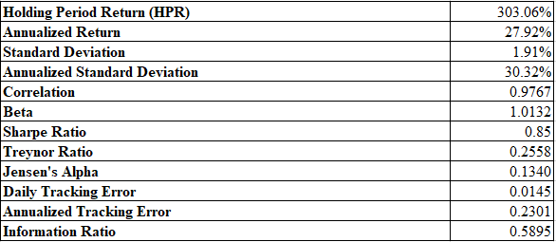
ProIndex Fund: Return and Risk Characteristics
Since its inception in 2009, we boast a cumulative return of 303.06% and an annualized return of 27.94%, which is 200% and 13% above our benchmark’s respective cumulative and annual returns.
We believe that our alpha, which is measured at .13, demonstrates our consistent and reliable outperformance above regular market movement.
Other highlights:
Market Correlation: .97
Beta: 1.0132 > 1
Information ratio: .5895
annual returns compared to the risk accepted is high

Slide 3
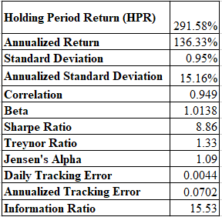
ProValue Fund: Return and Risk Characteristics
Since its creation, grew to over $7.8 million in value in one year from the base investment of $2 million
achieved through adding more value based stocks to the fund and through quantitative analysis to choose firms with the highest returns
The ProValue fund boasts a correlation of .95 to the index and a beta of 1.01
Our annualized tracking error for this fund suggests that it will return plus or
minus 7% year over year.

Slide 4
Mean Return, Variance, and Standard Deviation

Slide 5
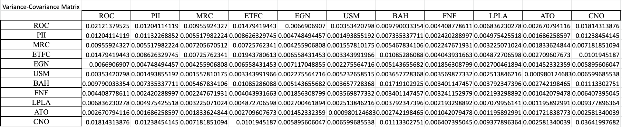
Variance-Covariance Matrix

Slide 6
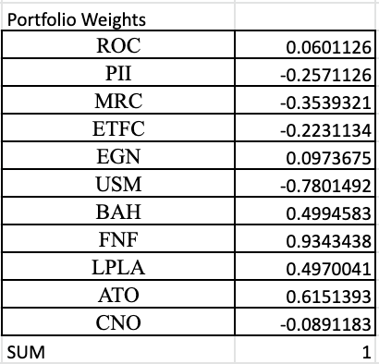
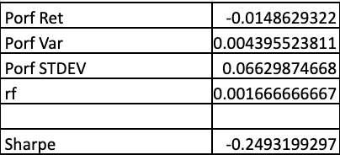
Optimal Portfolio Weights
Invest heavily in FNF, BAH, LPLA, and ATO
Short PII, MRC, ETFC, USM, and CNO

